Slide 1
Supervised Learning k Nearest Neighbors
?
?

Slide 2
k-Nearest Neighbors (KNN)
We will discover the k-Nearest Neighbors (KNN) algorithm for classification as-
The model representation used by KNN.
How a model is learned using KNN.
How to make predictions using KNN

Slide 3
KNN Model Representation
The model representation for KNN is the entire training dataset.
It has no-model other than storing the entire dataset, so there is no-learning required.
Because the entire training dataset is stored, you may want to think carefully about the consistency of your training data. It might be a good idea to curate it, update it often as new data becomes available and remove erroneous and outlier data.

Slide 4
Making Predictions with KNN
KNN makes predictions using the training dataset directly. Predictions are made for a new data point by searching through the entire training set for the k most similar instances (the neighbors) and summarizing the output as per those k instances.
To determine which of the k instances in the training dataset are most similar to a new input a distance measure is used.
The most popular distance measure is Euclidean distance. Euclidean distance is calculated as the square root of the sum of the squared differences between a point p and point q across all input attributes i.
Euclidean distance
d(p,q) = √∑(p_{i} – q_{i})²

Slide 5
Other popular distance measures include:
Hamming Distance: Calculate the distance between binary vectors.
Manhattan Distance: Calculate the distance between real vectors using the sum of their absolute difference. Also called City Block Distance.
Minkowski Distance: Generalization of Euclidean and Manhattan distance.

Slide 6
K - Nearest Neighbors : Steps
For a given instance T, get the top k dataset instances that are “nearest” to T
Select a reasonable distance measure
Inspect the category of these k instances, choose the category C that represent the most instances (majority)
Conclude that T belongs to category C

Slide 7
k Nearest Neighbor
k = 1:
Belongs to square class
k = 3:
Belongs to triangle class
?
k = 7:
Belongs to square class

Slide 8
k Nearest Neighbor
K-nearest neighbors of a record x are data points that have the k smallest distance to x

Slide 9
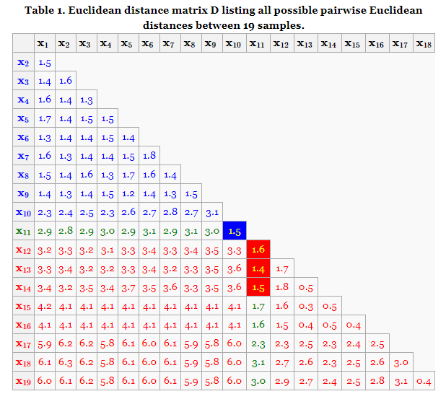
shows an X-Y scatterplot of the 19 samples plotted as a function of their X and Y values. One can notice that among the four samples closest to test sample x11(labeled green), 3/4 of the class labels are for Class A (red color), and therefore, the test sample is assigned to Class A.

Slide 10
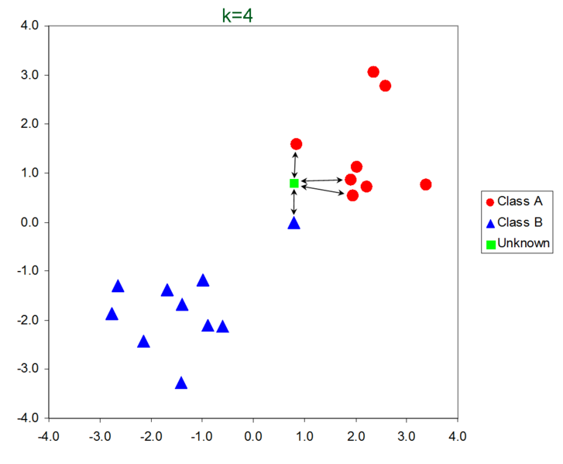
X-Y Scatterplot of the 19 samples for which pairwise Euclidean distances are listed in Table 1. Among the 4 nearest neighbors of the test sample, the most frequent class label color is red, and thus the test sample is assigned to the red class.

Slide 11
Estimation of K
The value for k can be found by algorithm tuning. It is a good idea to try many different values for k and see what works best for your problem. The computational complexity of KNN increases with the size of the training dataset.
Choosing the value of k:
If k is too small, sensitive to noise points
If k is too large, neighborhood may include points from other classes
Choose an odd value for k, to eliminate ties

Slide 12
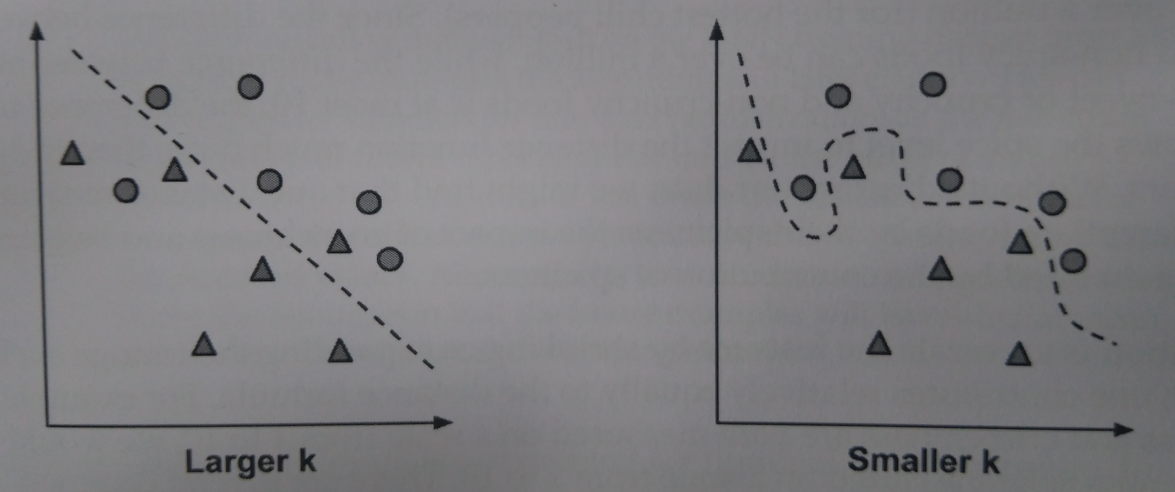
Choosing large k reduces the impact and variance caused by noisy data (it smooths the boundary), but can bias the model (it ignores small but important patterns)

Slide 13
Suppose, we took extremely large k, as large as the total number of observations in the training data. In this case, the most common class always has a majority of the voters (always predict the majority class, regardless of the nearest neighbors).
On the opposite site, using single nearest neighbor allows the noisy data or outlier to influence the classification.
In practice, choosing k depends on the difficulty of the concept to be learned and the number of records in the training data set. One common practice is to begin with k equal to the square root of the number of dataset. Suppose, training examples are 15 and so k = 4.
However, such rules may not always work. Alternative approach is to test several k values on a variety of test datasets and choose the one that delivers best classification performance.
A less common , but interesting solution is to choose a large k, but apply a weighted voting where vote of the closer neighbor is considered more important.

Slide 14
KNN also known as-
Instance-Based Learning: The raw training instances are used to make predictions. As such KNN is often referred to as instance-based learning or a case-based learning (where each training instance is a case from the problem domain).
Lazy Learning: No learning of the model is required and all of the work happens at the time a prediction is requested. As such, KNN is often referred to as a lazy learning algorithm.

Slide 15
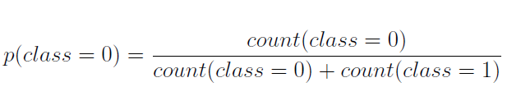
KNN for Classification
When KNN is used for classification, the output can be calculated as the class with the highest frequency from the k-most similar instances. Each instance in essence votes for their class and the class with the most votes is taken as the prediction.
Class probabilities can be calculated as the normalized frequency of samples that belong to each class in the set of k most similar instances for a new data instance.
If you are using k and you have an even number of classes (e.g. 2) it is a good idea to choose a k value with an odd number to avoid a tie.

Slide 16
Summary- k Nearest Neighbor
Requires 3 things:
The set of stored records
Distance metric to compute distance between records
The value of k, the number of nearest neighbors to retrieve
To classify an unknown record:
Compute distance to other training records
Identify k nearest neighbors
Use class labels of nearest neighbors to determine the class label of unknown record (e.g., by taking majority vote)
?

Slide 17
Preparing Data For KNN
Rescale Data: KNN performs much better if all of the data has the same scale. Normalizing your data to the range between 0 and 1 is a good idea. It may also be a good idea to standardize your data if it has a Gaussian distribution.
Address Missing Data: Missing data will mean that the distance between samples cannot be calculated. These samples could be excluded or the missing values could be imputed.
Lower Dimensionality: KNN is suited for lower dimensional data. You can try it on high dimensional data (hundreds or thousands of input variables) but be aware that it may not perform well. KNN can benefit from feature selection that reduces the dimensionality of the input feature space.
Fuzzification: it is a transformation which exploits uncertainty in feature values in order to increase classification performance.

Slide 18
Discussion on the k-NN Algorithm
The k-NN algorithm for continuous-valued target functions
Distance-weighted nearest neighbor algorithm
Weight the contribution of each of the k neighbors according to their distance to the query point x_{q}
giving greater weight to closer neighbors
Similarly, for real-valued target functions
Calculate the mean values of the k nearest neighbors
Replace least square error method with KNN in regression

Slide 19
k Nearest Neighbor Advantages
Simple technique that is easily implemented
Building model is cheap
Extremely flexible classification scheme
Well suited for
Multi-modal classes

Slide 20
k Nearest Neighbor Disadvantages
Requires distance computation of k-nearest neighbors
Computationally intensive, especially when the size of the training set grows
Accuracy can be severely degraded by the presence of noisy or irrelevant features

Slide 21
k-NN Time Complexity
Suppose there are m instances and n features in the dataset
Nearest neighbor algorithm requires computing m distances
Each distance computation involves scanning through each feature value
Running time complexity is proportional to m X n

Slide 22
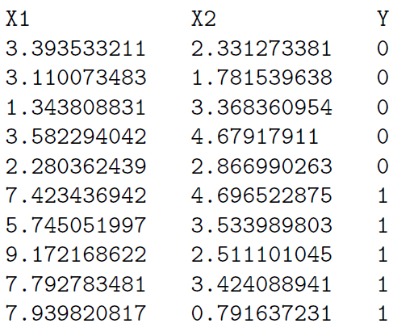
k-Nearest Neighbors Tutorial

Slide 23
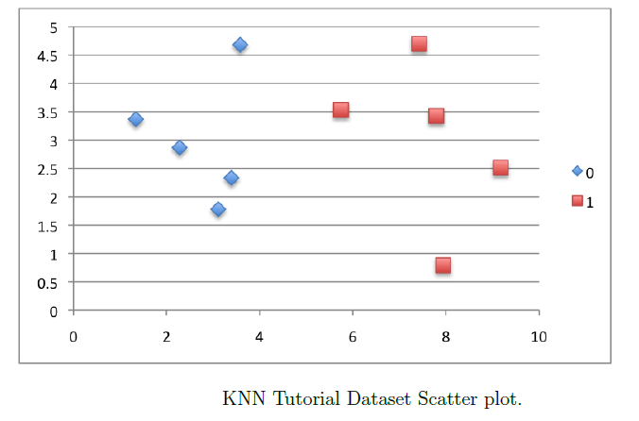
Data for each class is quite separated

Slide 24
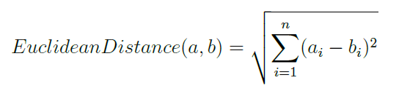
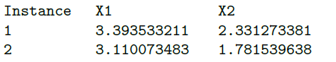
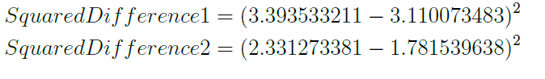
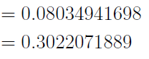
KNN and Euclidean Distance

Slide 25
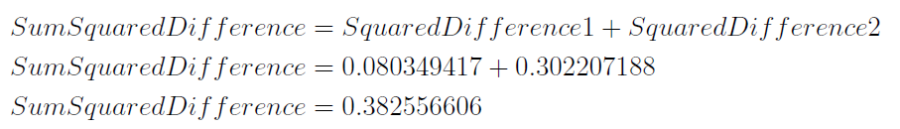
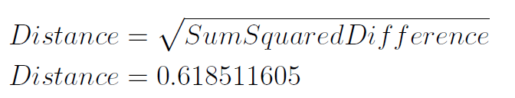

Slide 26
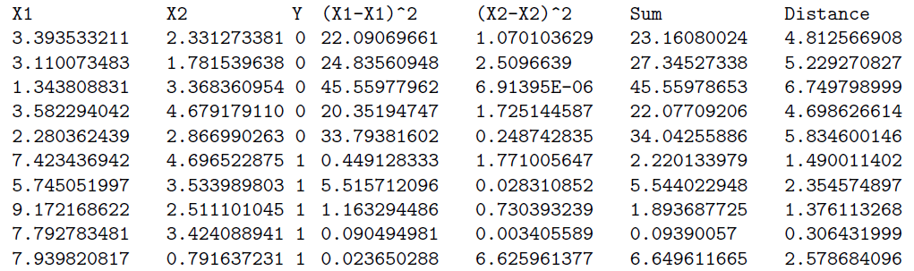
Making Predictions with KNN
Instance: X1 = 8:093607318, X2 = 3:365731514,

Slide 27
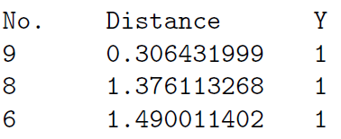
Suppose, K=3
we can use the MODE() statistical function in a spreadsheet to return the most frequent value.
prediction = mode(class(i))

